Slide 1
FIFA Player Data Mining Project
Hannah Culliton,
Gaurav Kondopraum,
Afreen Shakih, Jibin Thomas

Slide 2





About FIFA
FIFA
FIFA oversees game play regulations, organizes competitions, and oversees the transfer of players- they release stats every year
Leagues
There are many leagues around the world EPL, La Liga, Serie A etc.
Clubs
Clubs are teams.
Players
Players play for clubs and can be traded.

Slide 3
Our Project Significance
“The future of player recruitment is very much complementing traditional scouting with the use of data. Soccer has been later than other sports in embracing data and analytics. It is a world where ‘gut feeling’ and experience in the game is often still valued above statistical evidence.”
- Forbes (2018)

Slide 4





Our Project Overview
Web Scraping and Cleansing
Descriptive Analysis
Exploratory Analysis
Predictive Analysis
Select Data
01
02
03
04
05
We selected our data from SoFIFA.com because it had the most comprehensive player dataset.
We web scraped and cleansed our data from SoFIFA.com to R using the rvest package.
We conducted descriptive analytics to find things such as mean, range and IQR.
We answered 4 exploratory analysis questions about our dataset.
We built a predictive model based on our dataset.

Slide 5
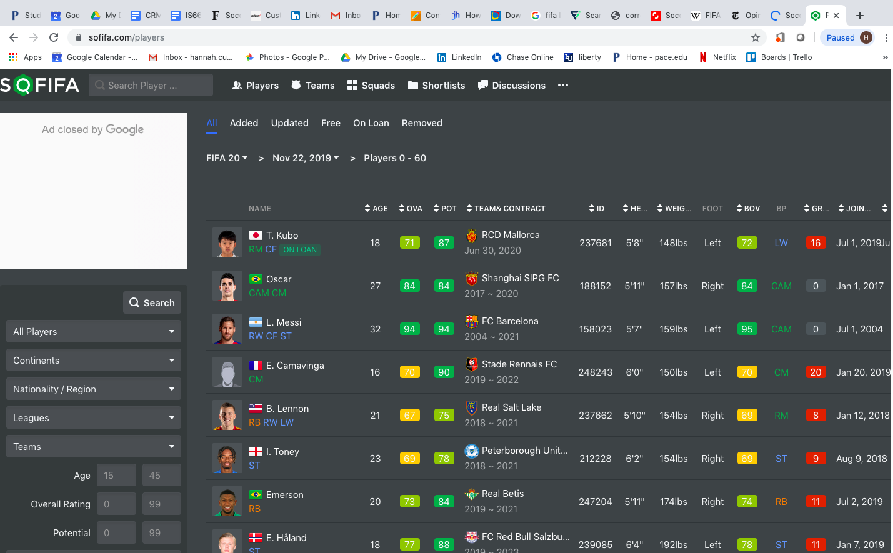
Data Selection

Slide 6



Data Mining and Cleansing
Web Scraping and Cleansing Directly From SoFIFA to R
Step 1
Step 2
Step 3
We first attempted to web scrape from SoFIFA directly to an R data frame and it worked! It took around 17 hours to mine one season from the website for 18,000 entries and we wanted to do this for 5 seasons. We needed to cut down the amount of entries.
This Crashed Our Laptops
However the dataset was so big and us being broke graduate students did not have the right processors in our laptops to handle that much data. It was taking an entire day just to scrape one season off the website. So we dropped the number of players down to about 3,000 per season.
Web Scraped Each Season Into Excel
We then transformed the scraped the data into excel files and used these files for our dataset. We scraped so much data the website blocked our IP address, so we had to go Starbucks hopping for Wi-Fi to get the best possible, super clean data! In the end we were able to get an extremely clean and usable dataset!

Slide 7
Descriptive Analysis
26
76
Median Age of Entire Player Dataset
Mean Overall Player Rating
€40,680
94
Highest Player Overall Rating
Median Weekly Player Wage

Slide 8
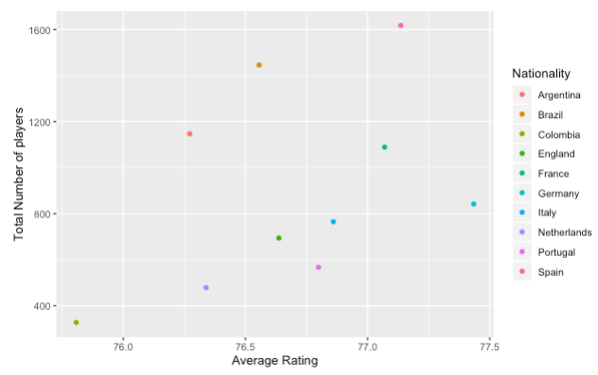
Exploratory Analysis: Q1
Question: Which country produces the most players with the highest collective overall rating?
Answer: Germany. Not surprising that they were the 2014 FIFA and 2017 Confederation Cup champions.

Slide 9
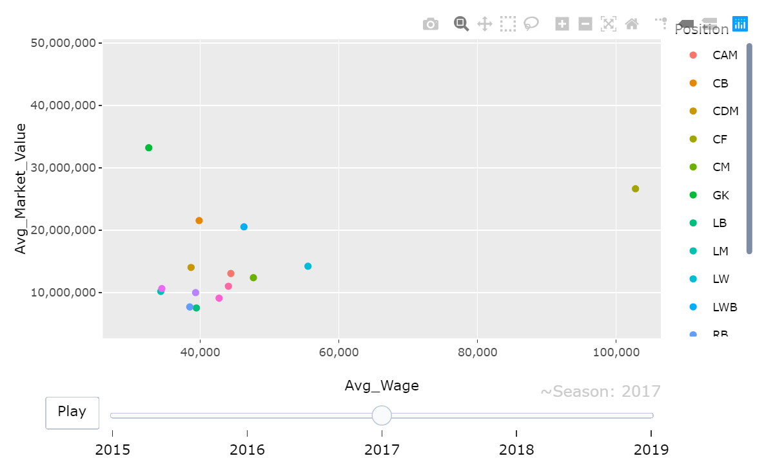
Exploratory Analysis: Q2
Question: Player playing at which position had the highest wage over the years?
Answer: Central Forwards had the highest pay in the 2017 Season.

Slide 10
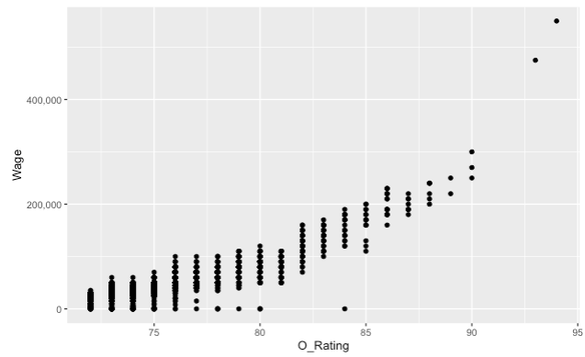
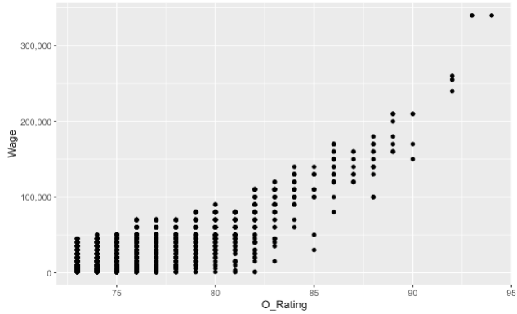
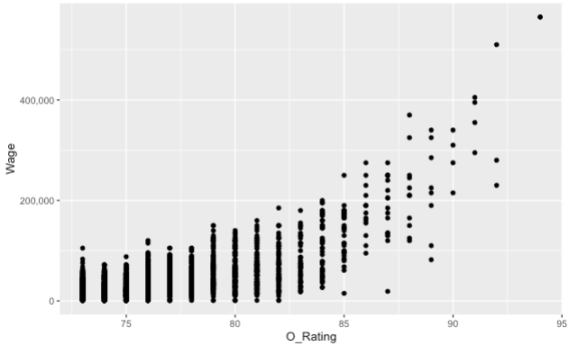
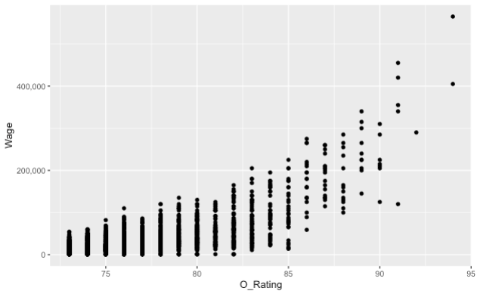

Exploratory Analysis: Q3
2015
2016
2017
2018
2019
Question: What is the correlation between wage and overall rating?
Answer: Wage is effected by more than just O_Rating, it has been getting more variable over time.

Slide 11
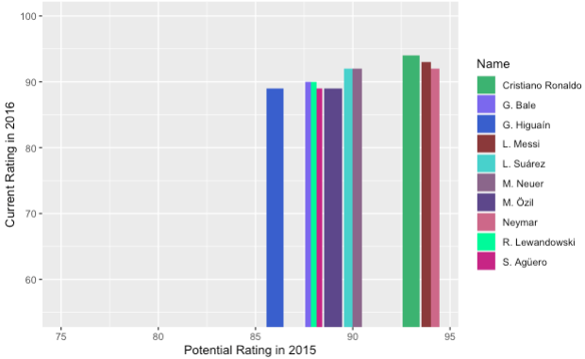
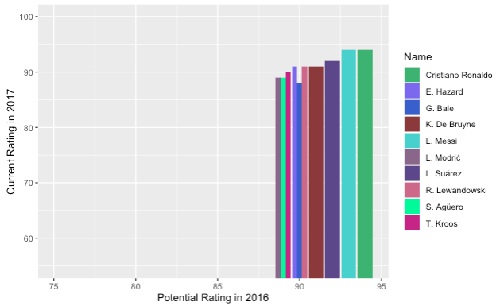
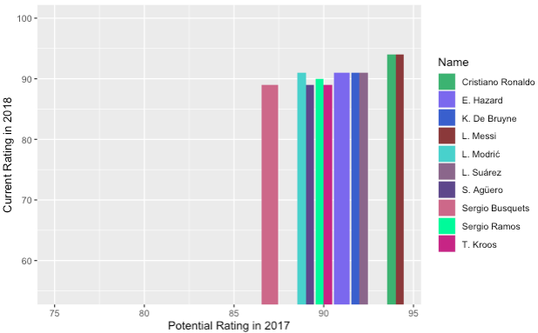
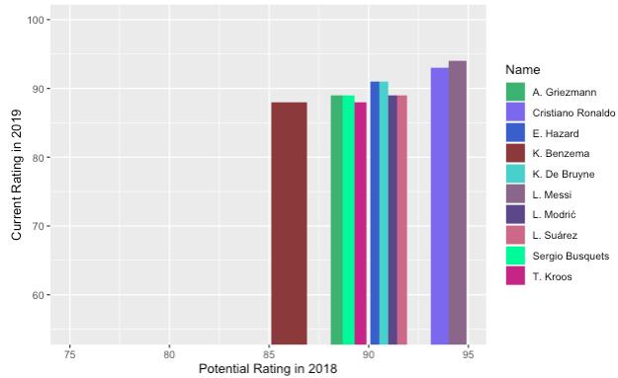
Exploratory Analysis: Q4
Question: Have the highest paid players in the league met their potential rating from the previous year with their current rating from the current year?
Answer: Yes, the highest paid players tend to improve remain the same YOY.

Slide 12
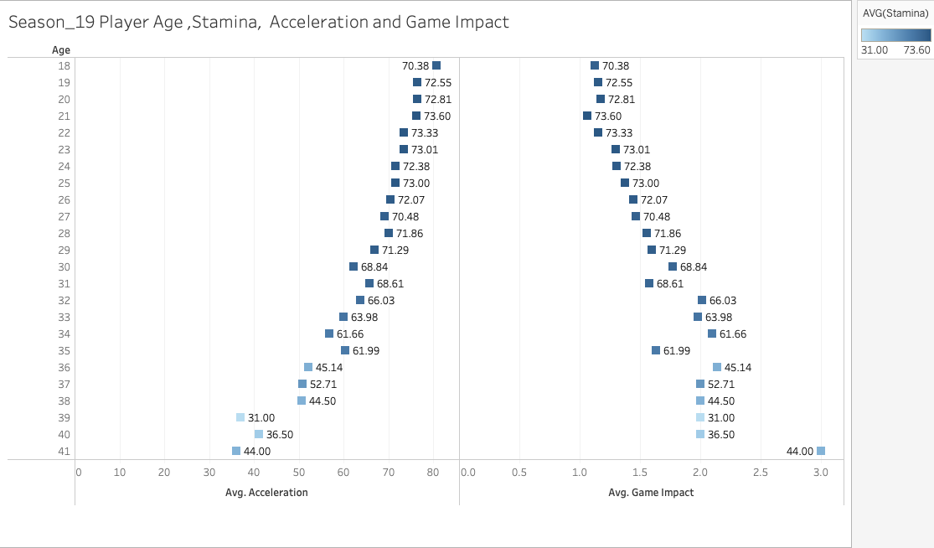
Exploratory Analysis: Q5
Question: What is the correlation between Player Age, Stamina, Acceleration and Game Impact for Season 2019?
Answer: Age 18-29 players have a relatively high stamina, game impact increases with age and acceleration decreases with age.

Slide 13
Predictive Analysis: Linear Multi-Regression Model Building
01
Independent Variables
03
Model Justification based on DV
Age, Stamina, Growth, Maturity, Market Value, Wage
Since most of our variables are numerical variables, we decided to use linear models.
02
Dependent Variables
04
Any Preprocessing
- Overall Rating
We did operations that hinted that 27 was the peak age of a player compared to their performance. We decided to select the same set of players who are 27 in 2019 and then look at the same players 5 years back to 2015.

Slide 14
Variable Correlations
Wage increases when overall rating increases with a covariance of 0.691
Overall rating and Maturity have a correlation of 0.3375
Overall rating and potential rating have a correlation of 0.679

Slide 15
Model Selection: Backward Elimination

Slide 16

Predictive Analysis: Model Results
Model Accuracy
4 significant variables
P-values= 2e-16 each with 3 stars
Adjusted R-square= 0.638

Slide 17
Interpretation of Results

Slide 18
Conclusion

